Slide 1
CVPR workshop figs
Link to overleaf

Slide 2
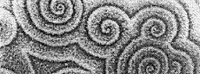
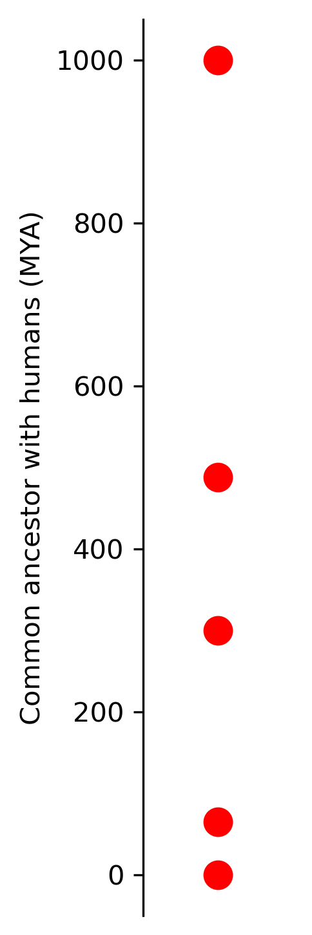
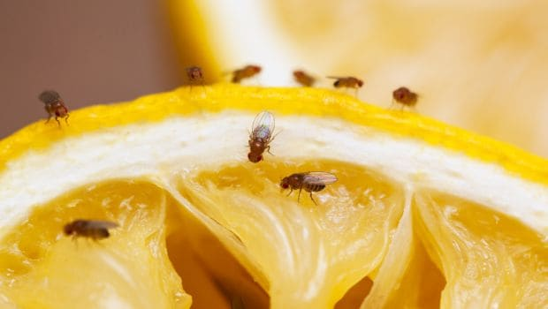
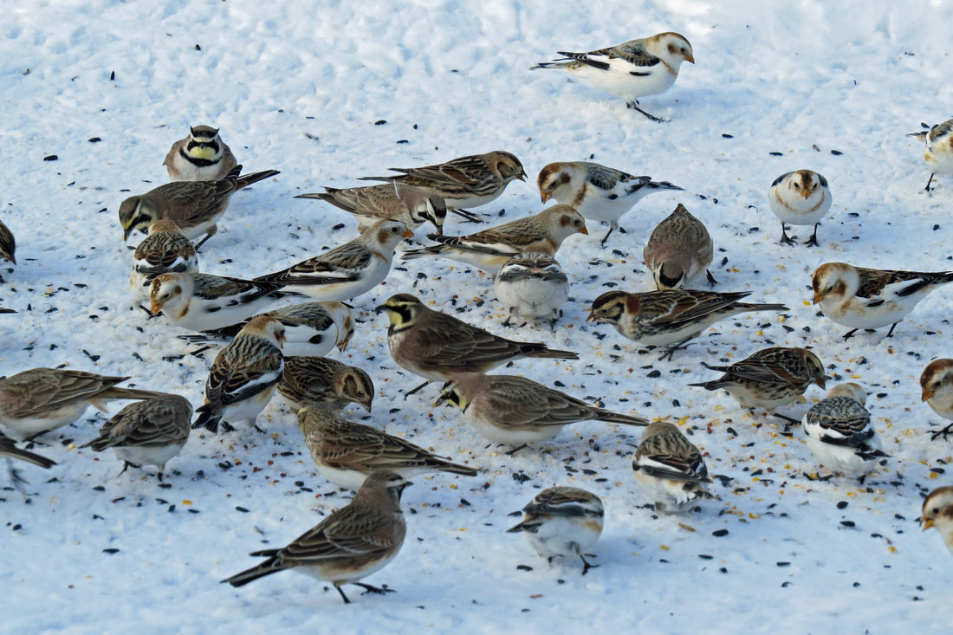
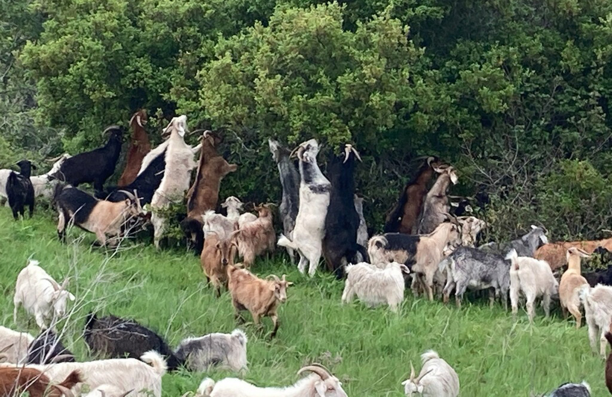
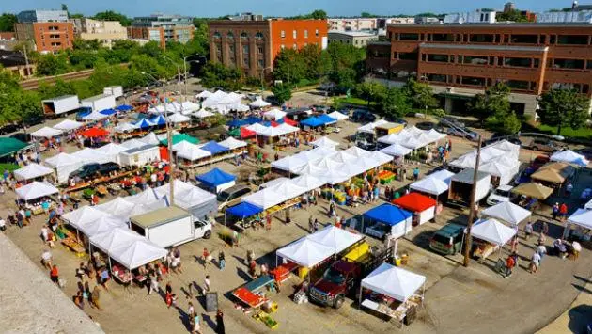
Notes:
http://abacus.gene.ucl.ac.uk/will/files/TreeOfLife.pdf
import matplotlib.pyplot as plt
import numpy as np
# Data points
years_ago = [1000, 488, 300, 65, .2]
# Plotting
fig, ax = plt.subplots(figsize=(1,6))
ax.plot([years_ago], 'ro', markersize=10) # 3700 MYA
ax.spines['top'].set_visible(False)
ax.spines['right'].set_visible(False)
ax.spines['bottom'].set_visible(False)
# ax.spines['left'].set_visible(False)
ax.xaxis.set_visible(False)
ax.set_ylabel('Common ancestor with humans (MYA)')
# Show the plot
# plt.show()
plt.savefig('/Users/emily/Downloads/plot.png', dpi=300, bbox_inches='tight')
# Close the plot
plt.close()

Slide 3
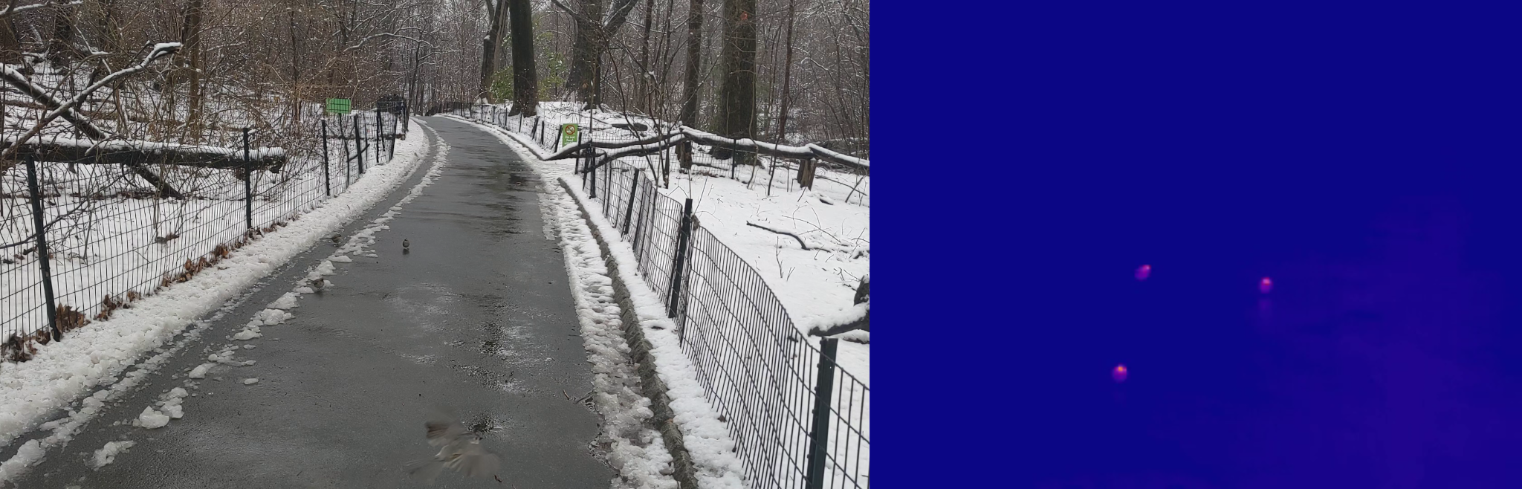
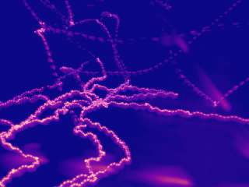
Thermal frame
Outdoor multi-agent foraging
RGB
Thermal
Identification
Tracking
RGB frame
Thermal max projection

Slide 4
TODO: go through intro, scrape references, add to list
Cognitive
Goal: Describe the computations underlying behavior in terms of goals, beliefs, and values
See work on reinforcement learning (Dayan, Niv, Gershman, Stachenfeld, Momennejad, Deepmind, …), and optimal foraging theory (Krebs, Charnov, El Hady, Hill, …)
Statistical
Goal: Fit empirical behavioral data
See work on minimal models (Levy Flights, Boids, and random walks, Bialek, Schneidman, …), and tracking video data (Sun, Kennedy, Pereira, Mathis, Perona….)
Neural
Goal: Uncover brain mechanisms behind behavior
See work on Drosophila (Jayaraman, Ruta, …), Nematodes (Bargmann, Calhoun,...), and Hippocampus (Stachenfeld, Ulanovsky, Barack, Aronov, …)

Slide 5
TODO: go through intro, scrape references, add to list
Cognitive
Goal: Describe the computations underlying behavior in terms of goals, beliefs, and values
Statistical
Goal: Fit empirical behavioral data
See work on minimal models (Levy Flights, Boids, and random walks, Bialek, Schneidman, …), and tracking video data (Sun, Kennedy, Pereira, Mathis, Perona….)
Neural
Goal: Uncover brain mechanisms behind behavior
See work on Drosophila (Jayaraman, Ruta, …), Nematodes (Bargmann, Calhoun,...), and Hippocampus (Stachenfeld, Ulanovsky, Barack, Aronov, …)
See work on reinforcement learning (Dayan, Niv, Gershman, Stachenfeld, Momennejad, Deepmind, …), and optimal foraging theory (Krebs, Charnov, El Hady, Hill, …)

Slide 6
OLD after this

Slide 7
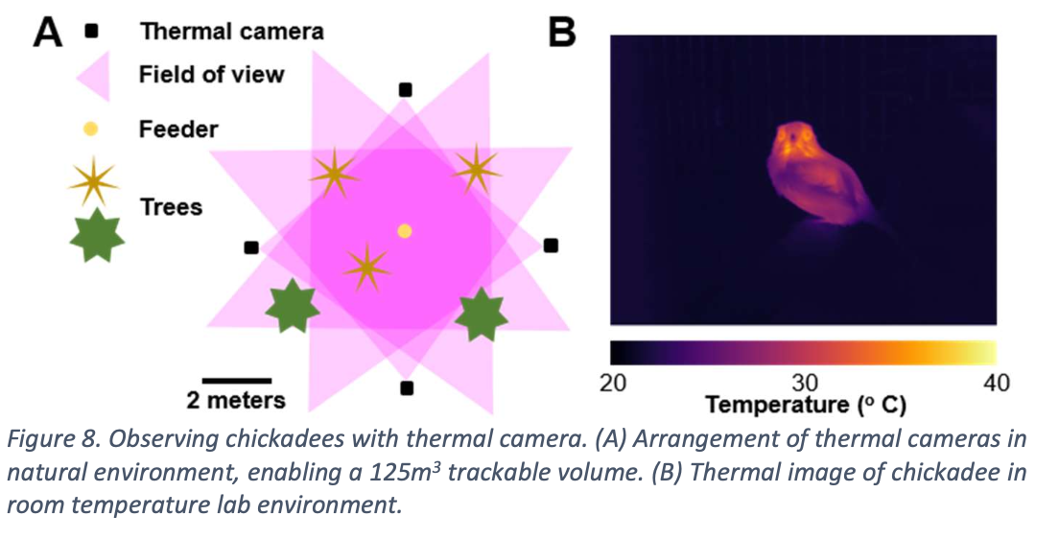
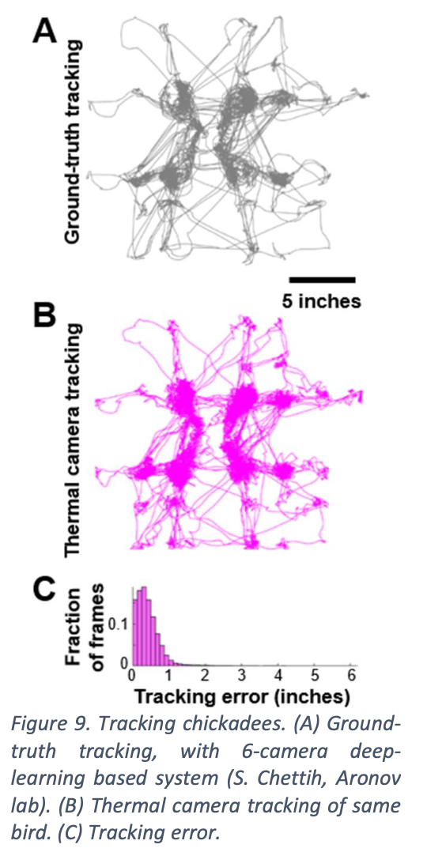
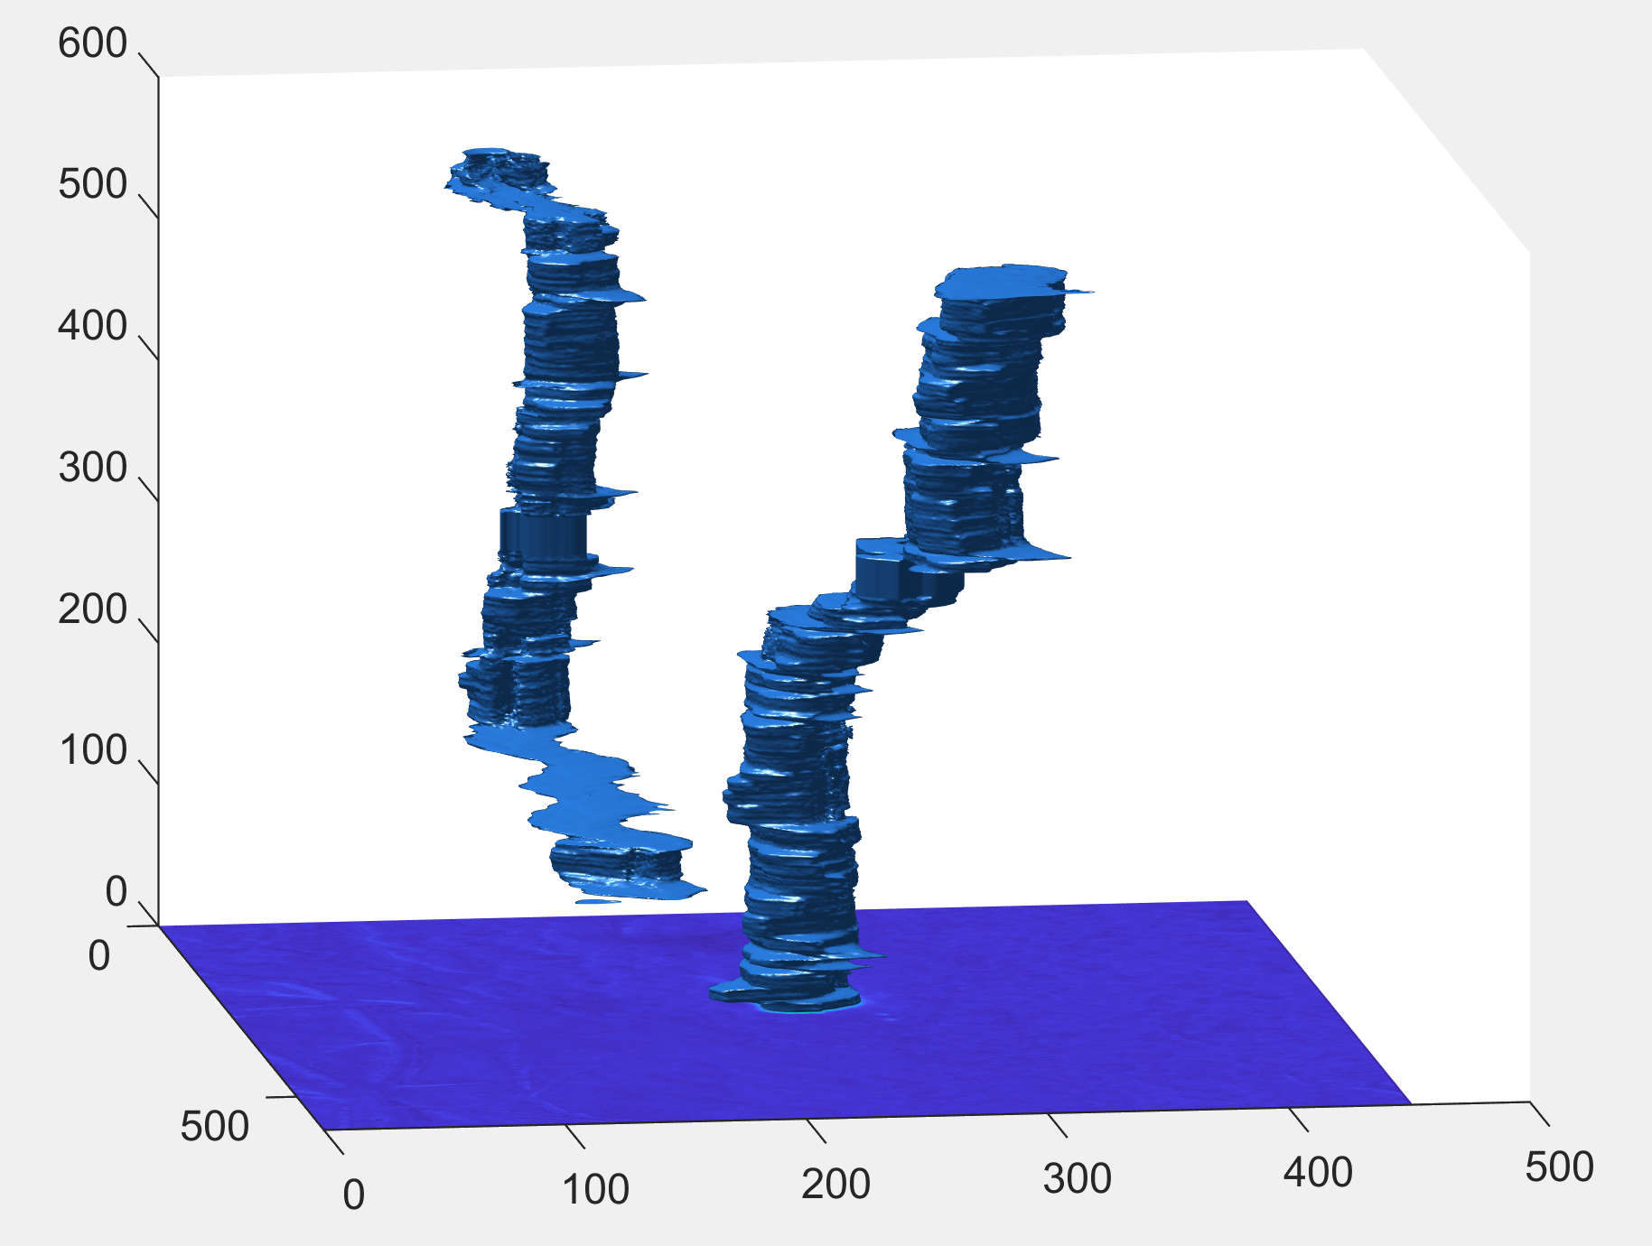
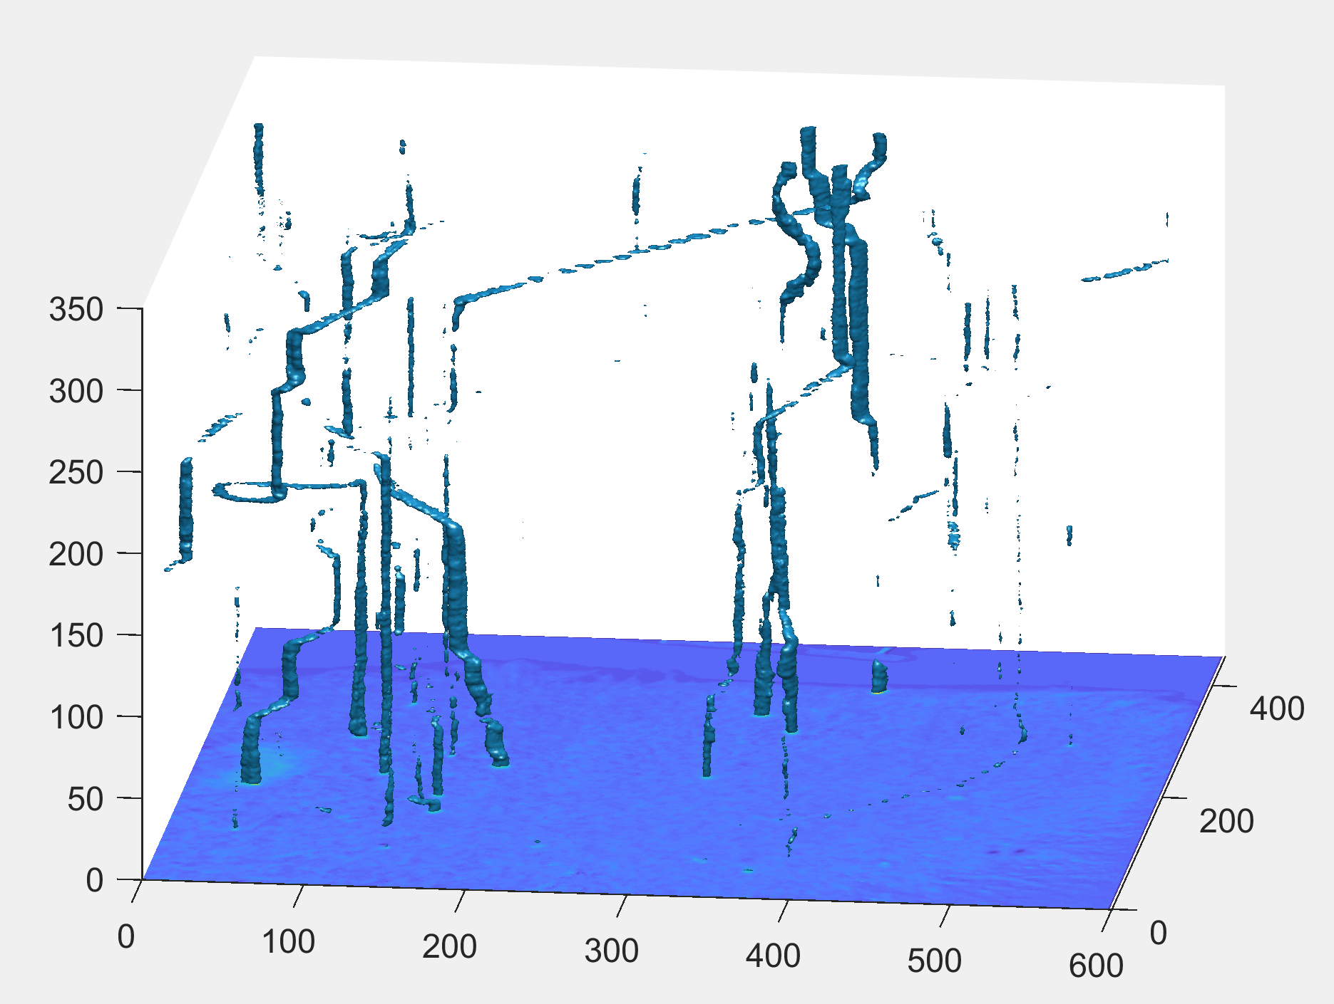
Grab bag of some possible fieldwork figure panels

Slide 8
A
C
Thermal frame
Outdoor multi-agent foraging
RGB
Thermal
Identification
Tracking
B
RGB frame
D
Thermal max projection

Slide 9
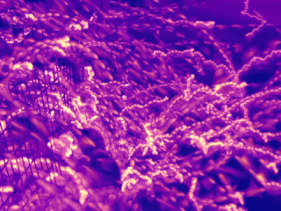

Slide 10
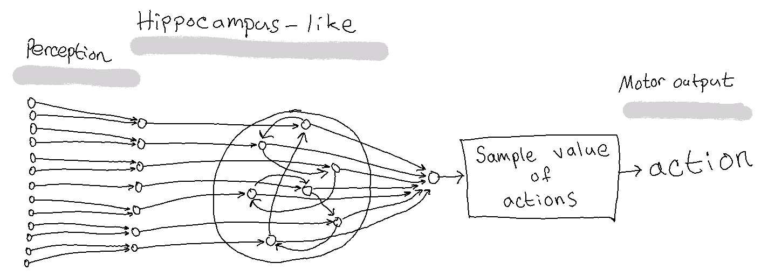
Cognitive
Neural
Statistical

